Slide 1
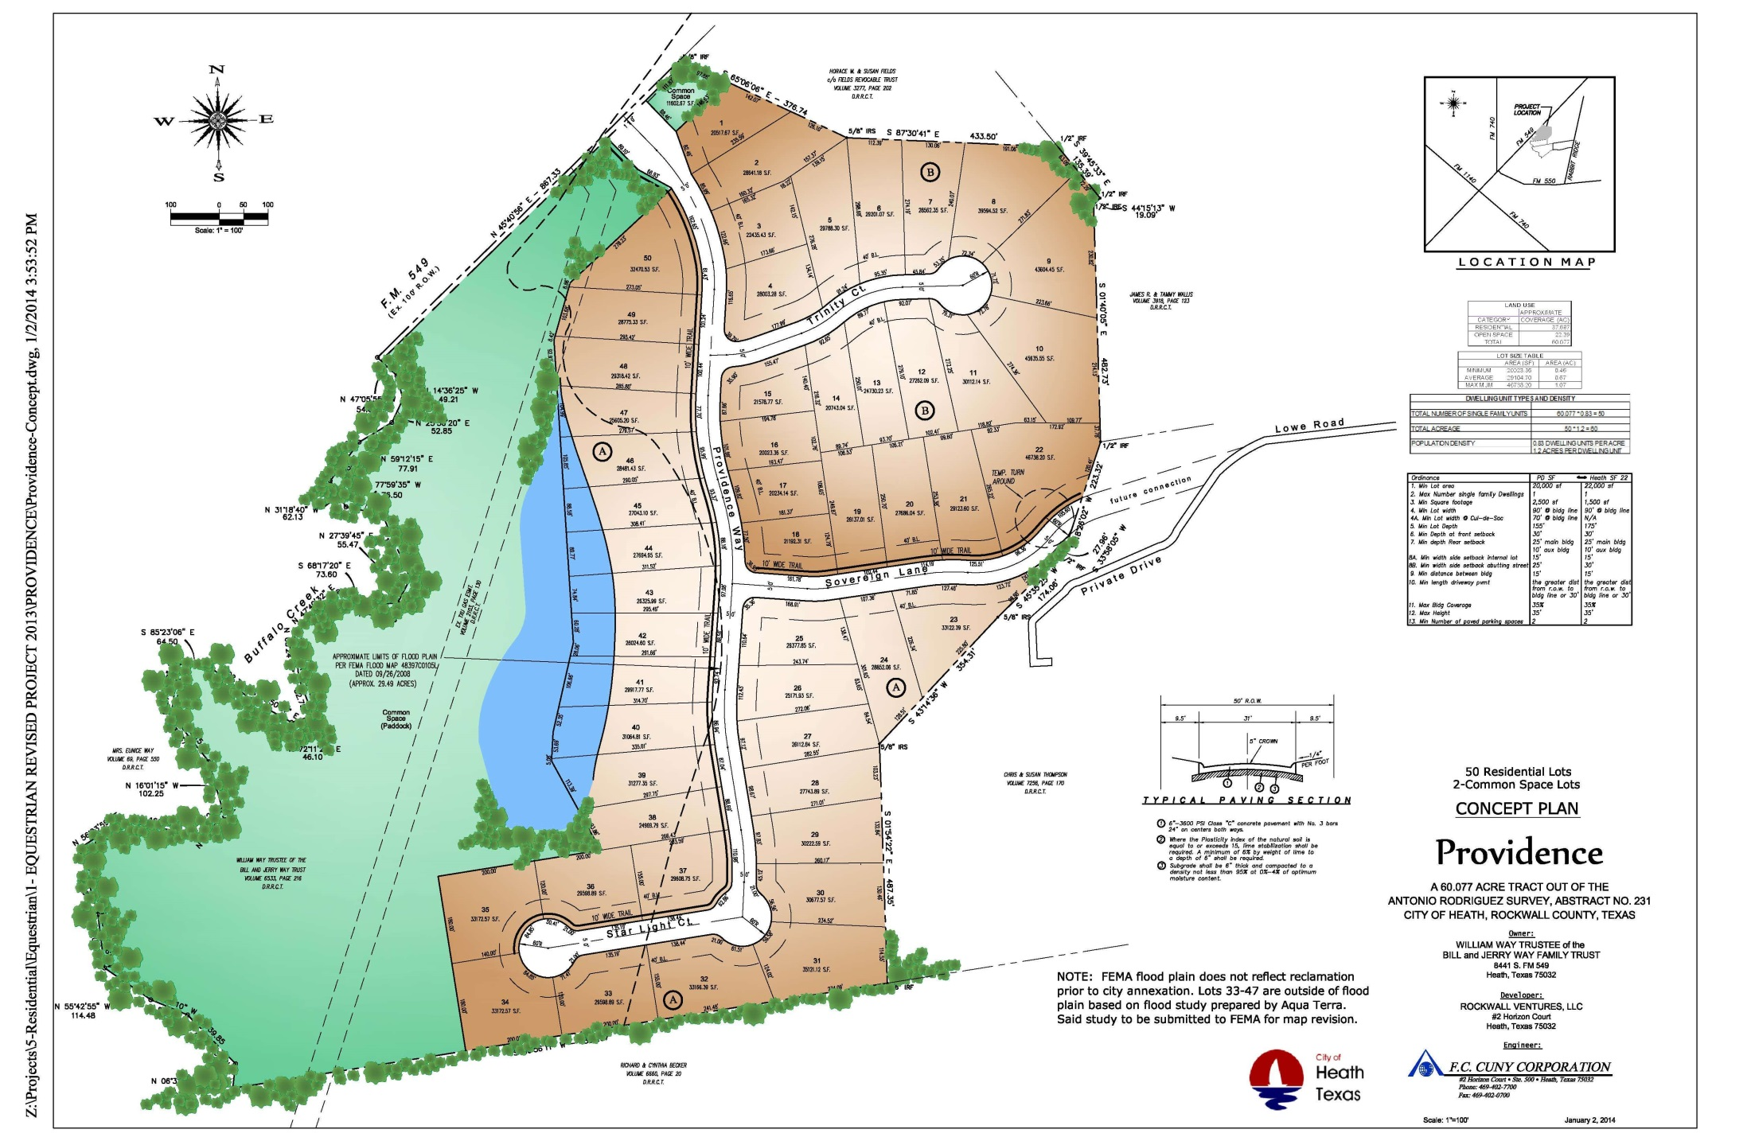

Slide 3
Providence – Proposed Variance Table

